Slide 1

Interpretable survival models
“survxai” package
Aleksandra Grudziąż, MI² Group
Warsaw, 29.09.2019
Notes:
hello, My name is Ola Grudziąż, I’m the Master Studies student from University of Warsaw, faculty of Mathematics, Informatics and Mechanics, I’m also a member of already mentioned here MI² group. a year ago i was working at the warsaw university of technology and I was dealing with biological and medical analyses and model interpretability. For a year now I have been conducting a completely new type of research as a mother of a wonderful son Grześ.
For the next 17 minutes I will tell you about what I think is an interesting tool that can help some mathematicians to communicate for example with doctors. ------------------------------------------------------------------------

Slide 2
Interpretability
Explanation is an answer to a why-question.
Notes:
First of all, we're gonna figure out what's underneath the concept of interpretability.
Interpret means to explain or to present in understandable terms. Explanation can be answer to a why question

Slide 3
Interpretability
Explanation is an answer to a why-question.
No mathematical definition :)
Notes:
As far as I know there is no specific, mathematical definition of interpretability (tzm so with epsilons and deltas :)).

Slide 4
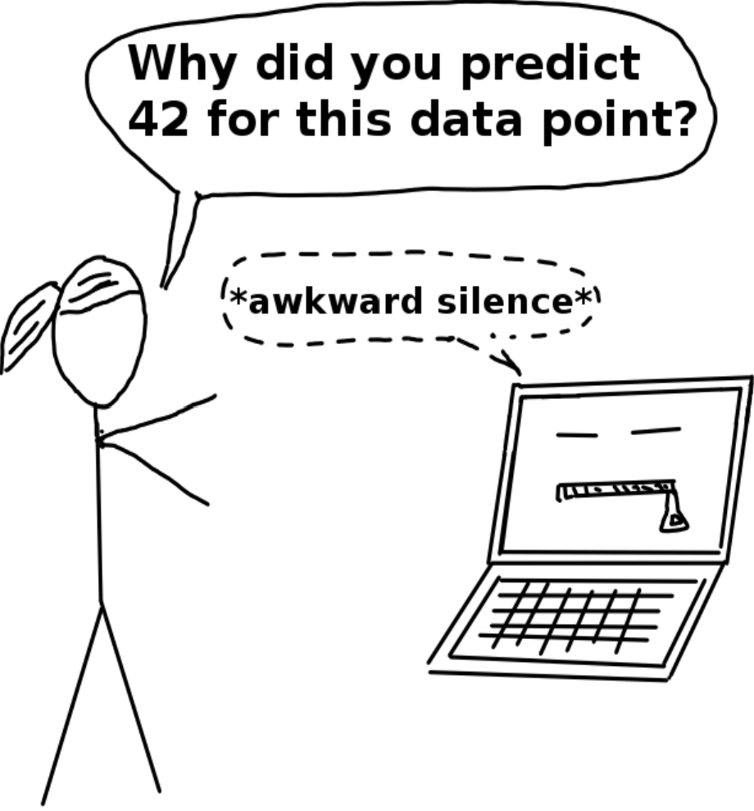
Interpretability
Explanation is an answer to a why-question.
No mathematical definition. :)
Explaining predictions.
Source: https://christophm.github.io/interpretable-ml-book/terminology.html
Notes:
In the context of data analysis, interpretability can be treated as an understanding of the results of analysis or model prediction. We do our best to make explanations of even complicated models easy to understand, not necessarily by people who have mathematical knowledge and know the basics of models.

Slide 5
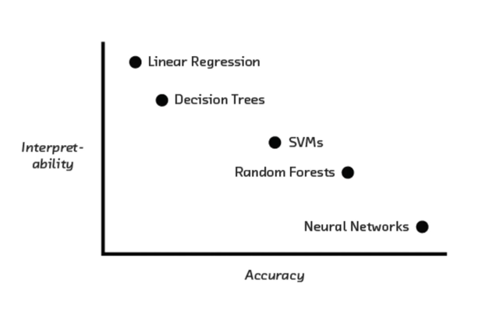
Accuracy / Interpretability trade-off
Source: https://www.kaggle.com/datacog314/tutorial-machine-learning-interpretability
Notes:
Unfortunately, we are very often confronted with the situation as in the picture.
It is the complicated models that give us better results.More, accuracy cannot stand alone for buiding trust on our models because of possible overfitting of the model, correlations of the features and noise in the data. That is why we need methods to explain how they work.

Slide 6
Global and local performance
Global:
Notes:
Before I go to explanations for models of survival analysis models will present the general division of explanations. We distinguish between global and local explanations.
Gloabal is about how the whole model behaves.

Slide 7
Global and local performance
Global:
model performance
Notes:
We may consider the model of performace in this case, i.e. explanations based on errors made by the model. This type is very helpful in comparing goodness of models.

Slide 8
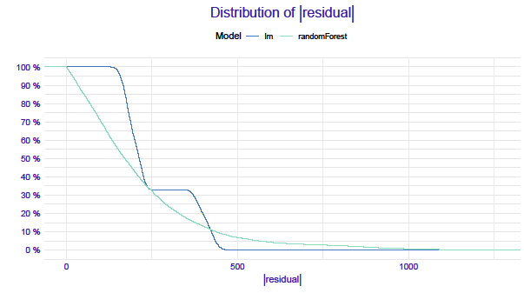
Notes:
An example of a quality study models shows a slide.
we see two models and distribution of their absolute values of residuals.

Slide 9
Global and local performance
Global:
model performance
changes in chosen variable
Notes:
on the other hand, we can focus on the model response for the selected variable, i.e. how the value of the prediction can vary depending on the value of the explanatory variable.

Slide 10
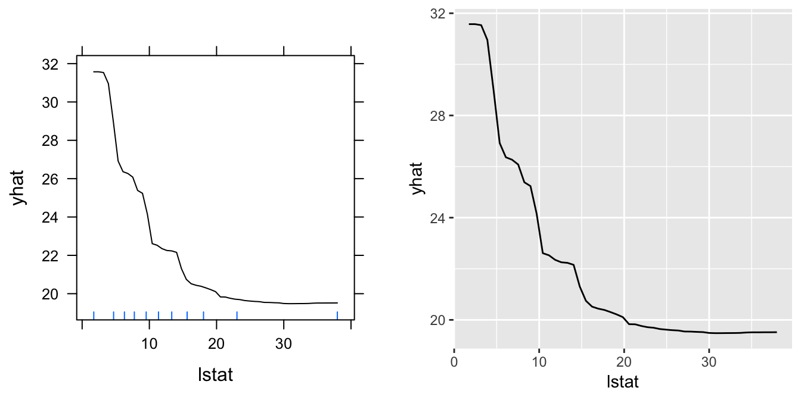
Notes:
an example of investigating of changing values in prediction can be a partial dependency plots given on a slide.
We see in what way prediction will change with changes in chosen variable for all observations.

Slide 11
Global and local performance
Global:
model performance
changes in chosen variable
Local:
Notes:
Local is how our model reacts to changes in the data for a specific observation.

Slide 12
Global and local performance
Global:
model performance
changes in chosen variable
Local:
changes in new observation, dependency on features
Notes:
More precisely we get new observations with specific values of variables and we can analyze how the prediction would change for observations with a change of one of the coordinates.Locally, the prediction might only depend linearly or monotonically on some features, rather than having a complex dependence on them.

Slide 13
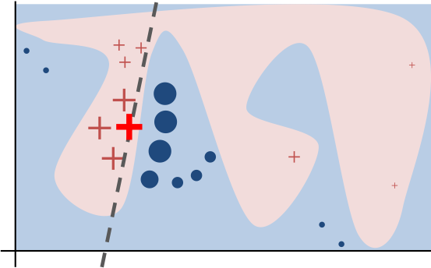
Notes:
for exampmle, In lime method we want to find simpler dependency for given observation, rather than given by model.

Slide 14
Global and local performance
Global:
model performance
changes in chosen variable
Local:
changes in new observation, dependency on features
contribution of variables
Notes:
Additionally, for the new observation we can examine what are the contributions of particular variables to the predictions - it allows us to find the most existent variables in this case.

Slide 15
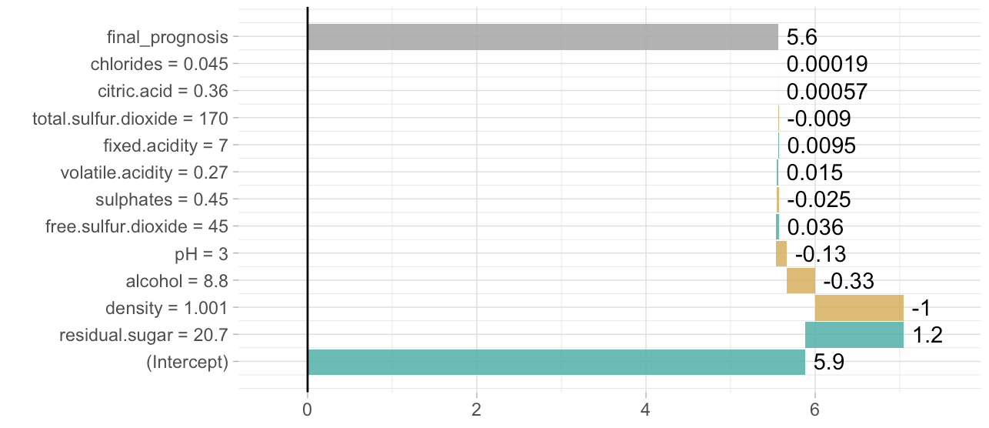
Notes:
The contributions of the variables can be extracted using the breakdown algorithm. we see which factors increase the prediction and which decrease it.

Slide 16

DrWhy.AI universe
Notes:
In our lab many tools have been created around the interpretation of different models of machine learning. These are largely R packages but also libraries for python. We have impleneted methods for both model specific (foe example randomForest) and model agnostic (independent from the model type)

Slide 17

Survival analysis
Examining the time until the event occurs
Source: Survival Analysis A Brief Introduction. https://slideplayer.com/slide/5878133/
Notes:
After the introduction to interpretability we will move to the regions concerning one of the statistical domains and more precisely to the analysis of survival.
Generally speaking, we want to estimate the time that will elapse to any event. The event can be the death of a patient, a device failure or an employee's departure from the company.
An important difference in terms of survival analysis models is the form of the explained variable. There is no prediction value here, e.g. the price of an apartment per square metre. Our prediction consists of two parts, the aforementioned time and the so-called observation status. The status is related to censoring

Slide 18
Survival analysis
Examining the time until the event occurs
Censoring
Source: Survival Analysis A Brief Introduction. https://slideplayer.com/slide/5878133/
Notes:
Censoring is used for those observations for which the event took place before or after the observation period (but it is not known exactly when), they are called respectively left- and right-censorsed data.

Slide 19
Kaplan-Meier estimator
Notes:
One of the basic tools of survival analysis is Kaplan Meier's estimator, which is used to estimate the survival function)

Slide 20
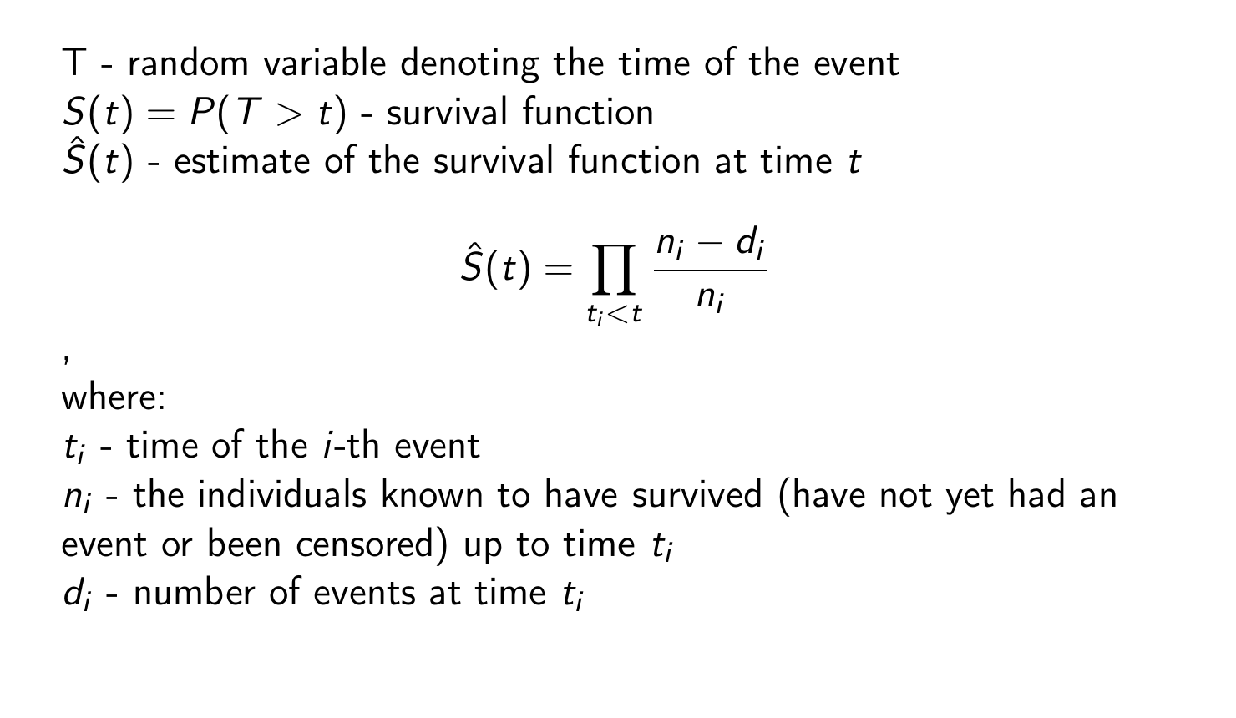
Kaplan-Meier estimator
Notes:
One of the basic tools of survival analysis is Kaplan Meier's estimator, which is used to estimate the survival function)
T stands for time of an event

Slide 21
Kaplan-Meier estimator

Slide 22
Kaplan-Meier estimator
Notes:
estimator is an product of factors in which

Slide 23
Kaplan-Meier estimator

Slide 24
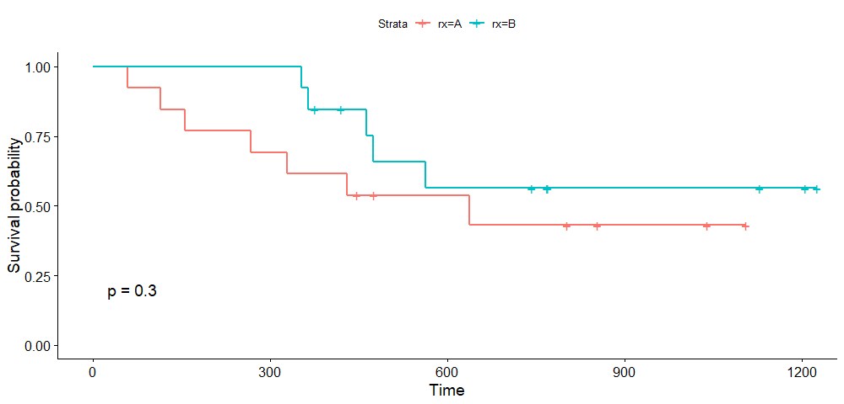
Survival curves
Notes:
The Kaplan-Meier estimator graph is a plot consisting of descending steps which, with large numbers of samples, approximate the true function of survival. The curve between the
individual points of events is a constant function. an example of plot for Kaplan-Meier estimators for two groups rx=A and rx=B. On x axis we have all time points form our data and on y axis we have the survival probability/

Slide 25
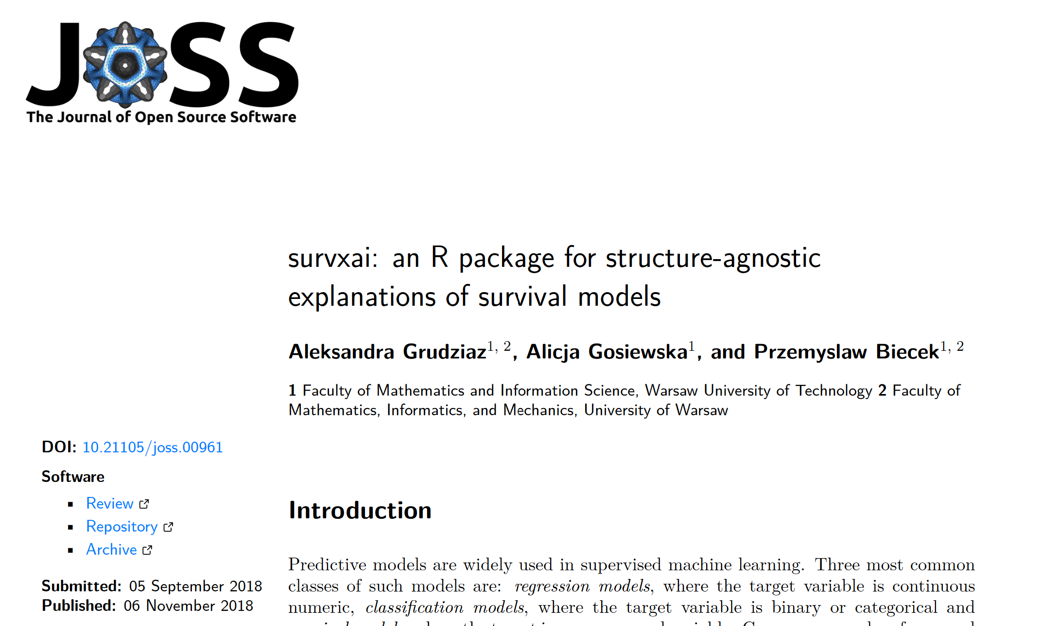
“survxai” package
Notes:
as we know survival models are used primarilly in medicine and churn analysis. As I said at the beginning of this presentation i have worked with doctors and each time I used a machine learning model, it took us a long time to analyse the results. Due to the fact that in cooperation with doctors very often the results are burdened with a specific responsibility, because for example, we are looking for a factor causing some disease, we want to know as accurately as possible why we have found one and not another answer to the model on our data. That's what made us create the package with explanators for the survival analysis models. Visualisations of methods in survxai are based on survival curves.

Slide 26
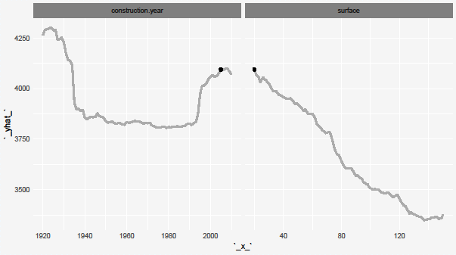
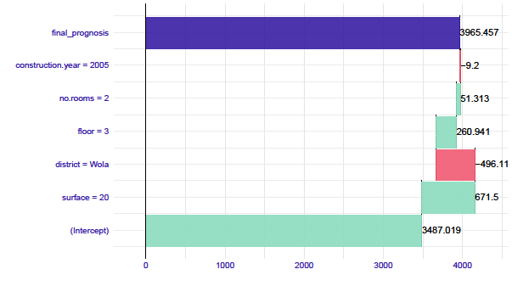
Interpretability methods
Notes:
In our package we have used four methods for interpretability for survival models based on methods developed for wider classes of models.
These methods are model performance , ceteris paribus , breakdown and partial dependency plots

Slide 27
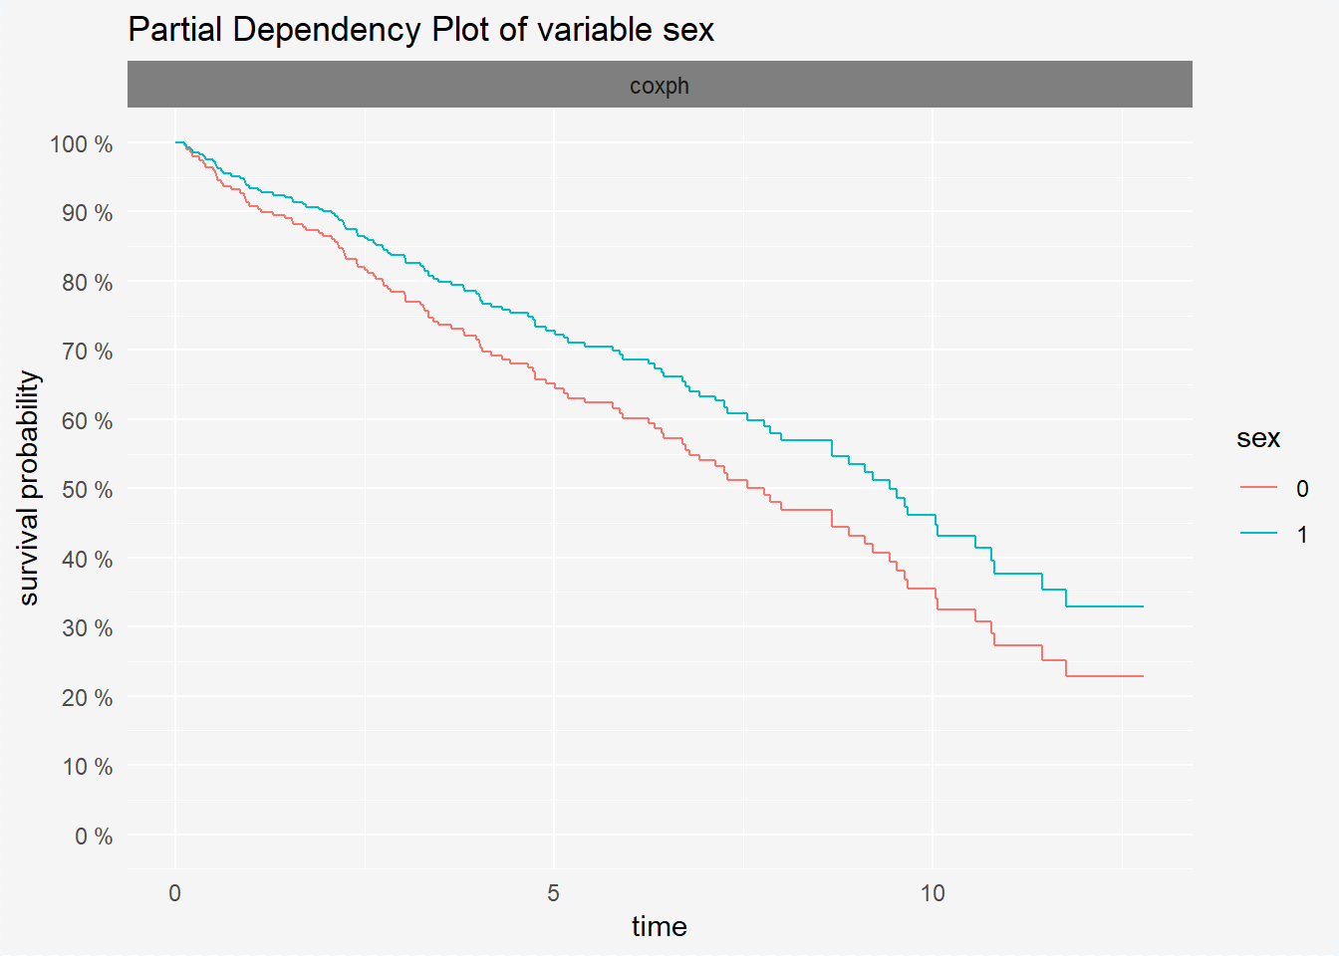
Partial Dependency Plots
Notes:
On the charts, we obtain a kind of new scenarios of situations in which we freeze the value of a selected variable. Next, calculate how the average survival curves for our observations
for other variables will change. By showing the relationship between survival probability and the value of a variable in this way, we can easily see which value of the variable causes the most significant differences in prediction.

Slide 28
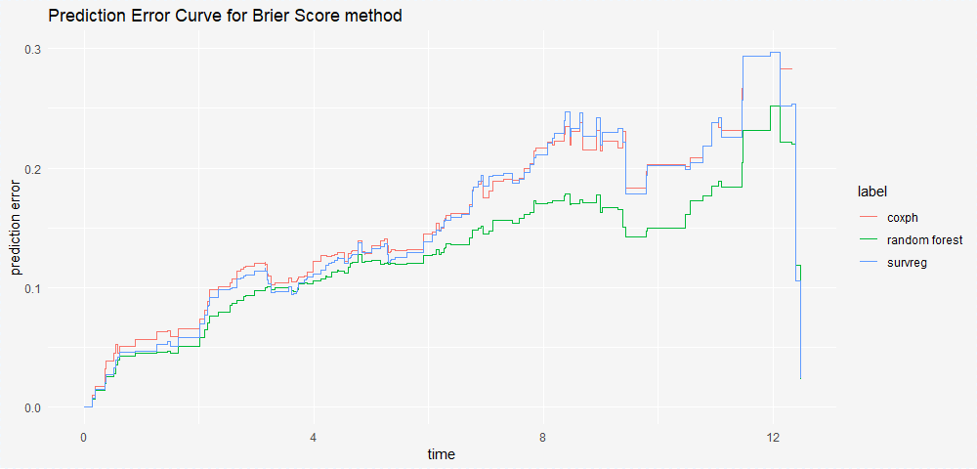
Model performance
Notes:
just as in the case of most models we rely on the examination of the residuals so for models of survival analysis we have a measure used to evaluate the model. This measure is the so-called brier score. It is a predictive error taken as the difference between the true observation status and what we get from the estimated survival function.
The graphic representation of this measure is the so-called prediction error curves that represent prediction error for the periods in the data, i.e., what is the time distribution of our errors.

Slide 29
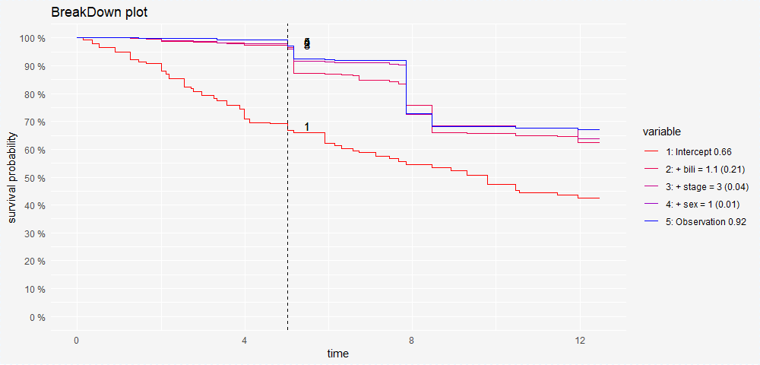
breakDown
Notes:
This method is based on breakdown algotithm in which we permute the values of all variables and gets their contributuons in prediction. I use the steps of this algorithm to adapt its operation to the survival analysis models. I look for variables that have the greatest contribution to the prediction and placed them in descending order. we compute the contribution to o one time point which can be easily set for example it can be a median time. breakdown for survival models helps to understand which factors drive the survvial probability.

Slide 30
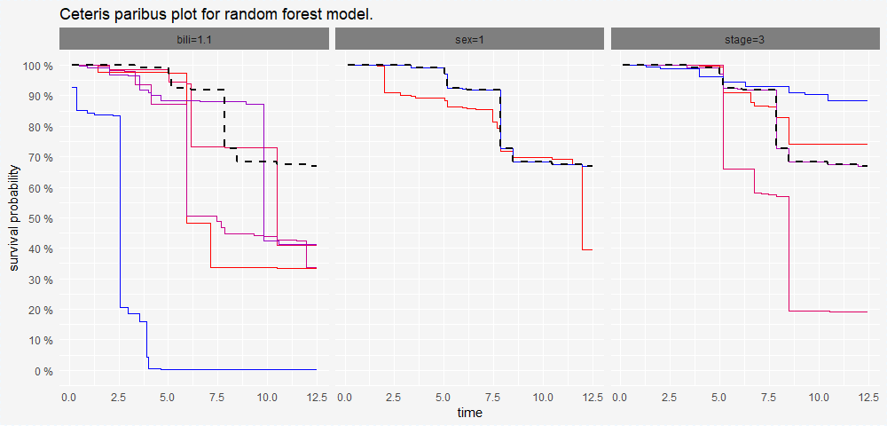
ceterisParibus - What If? plots
Notes:
Another method related to local explanations of machine learning models is Ceteris Paribus Profile. They present the model response around a single point in the feature space. In our case, these profiles show how survival curves change with change in the values of the individual variables in the model in new observation Every single panel shows how a model prediction (survival curve) would change if only a single variable were altered. It is useful for what-if reasoning. Each curve in a panel is related to a different value of the selected variable.

Slide 31
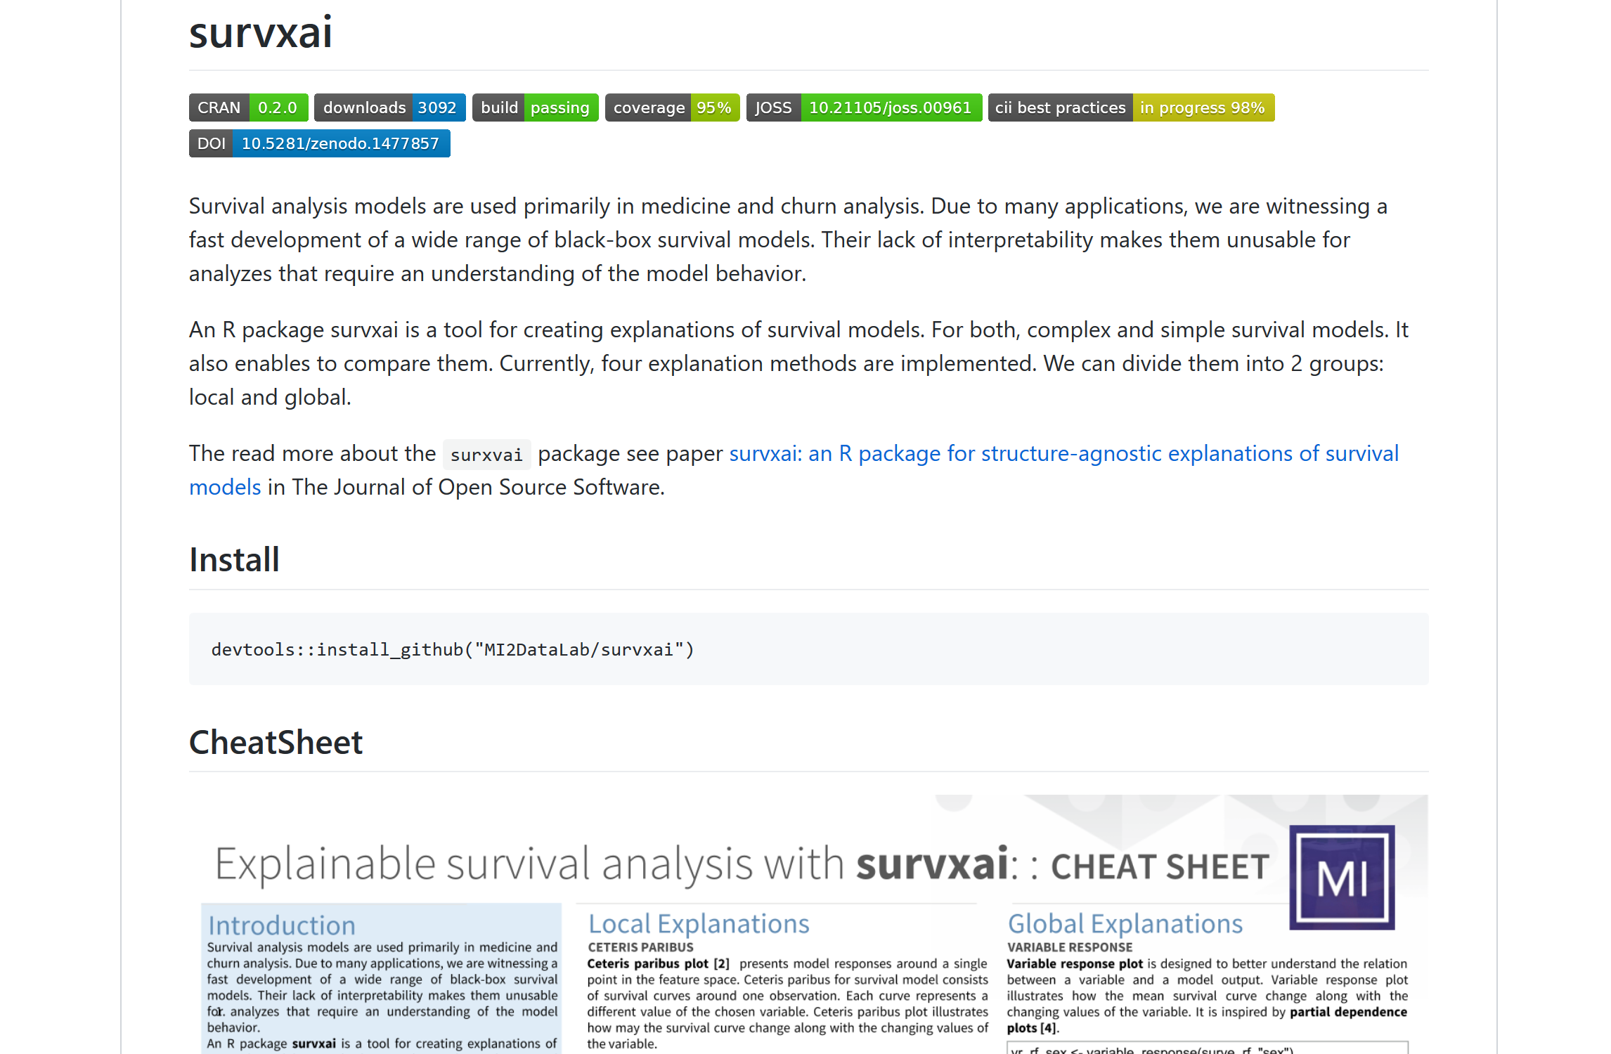
Notes:
a package with full documentation and cheatsheet are available on the cran

Slide 32


https://github.com/MI2DataLab/survxai
AleksandraDabrowska
aleksandra.grudziaz@gmail.com
Notes:
survxai development verison as most of our projects are in an open repository on lab github. if you want to collaborate you are welcome.

Slide 33

Notes:
at the very end, a small announcement. We are looking for people interested in developing artificial intelligence methods to work in our lab. You can find more information at the address visible on the screen or on Facebook.
thats the end of my presentation, thank you for your attention

